Slide 1



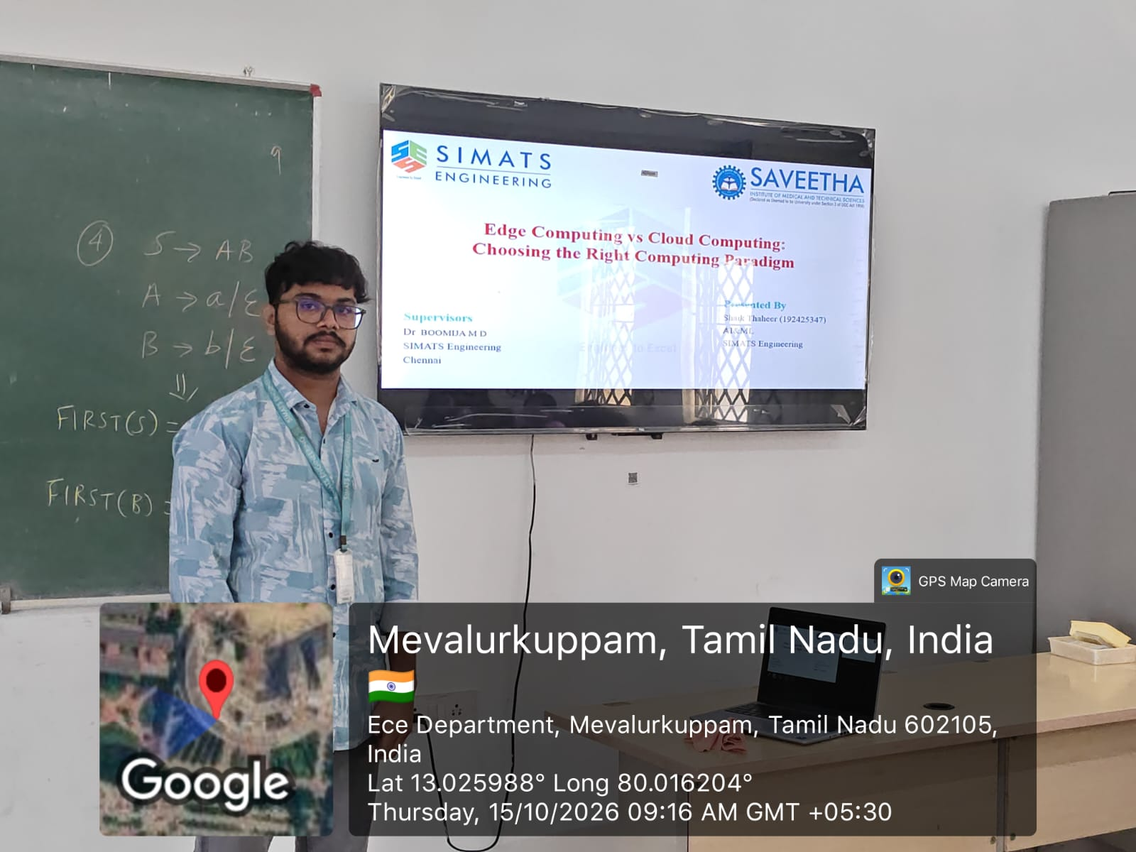

  Presented By

Slide 2
Edge Computing vs Cloud Computing:
Choosing the Right Computing Paradigm
  Presented By
  Shaik Thaheer (192425347)
  AI&ML
  SIMATS Engineering
  Supervisors
  Dr. BOOMIJA M D
  SIMATS Engineering
  Chennai

Slide 3


Objectives
To understand the concepts of Edge Computing and Cloud Computing.
To compare their architecture, working principles, advantages, and limitations.
To analyze real-world applications of both computing paradigms.
To identify the right computing approach based on latency, connectivity, storage, and performance requirements.

Slide 4
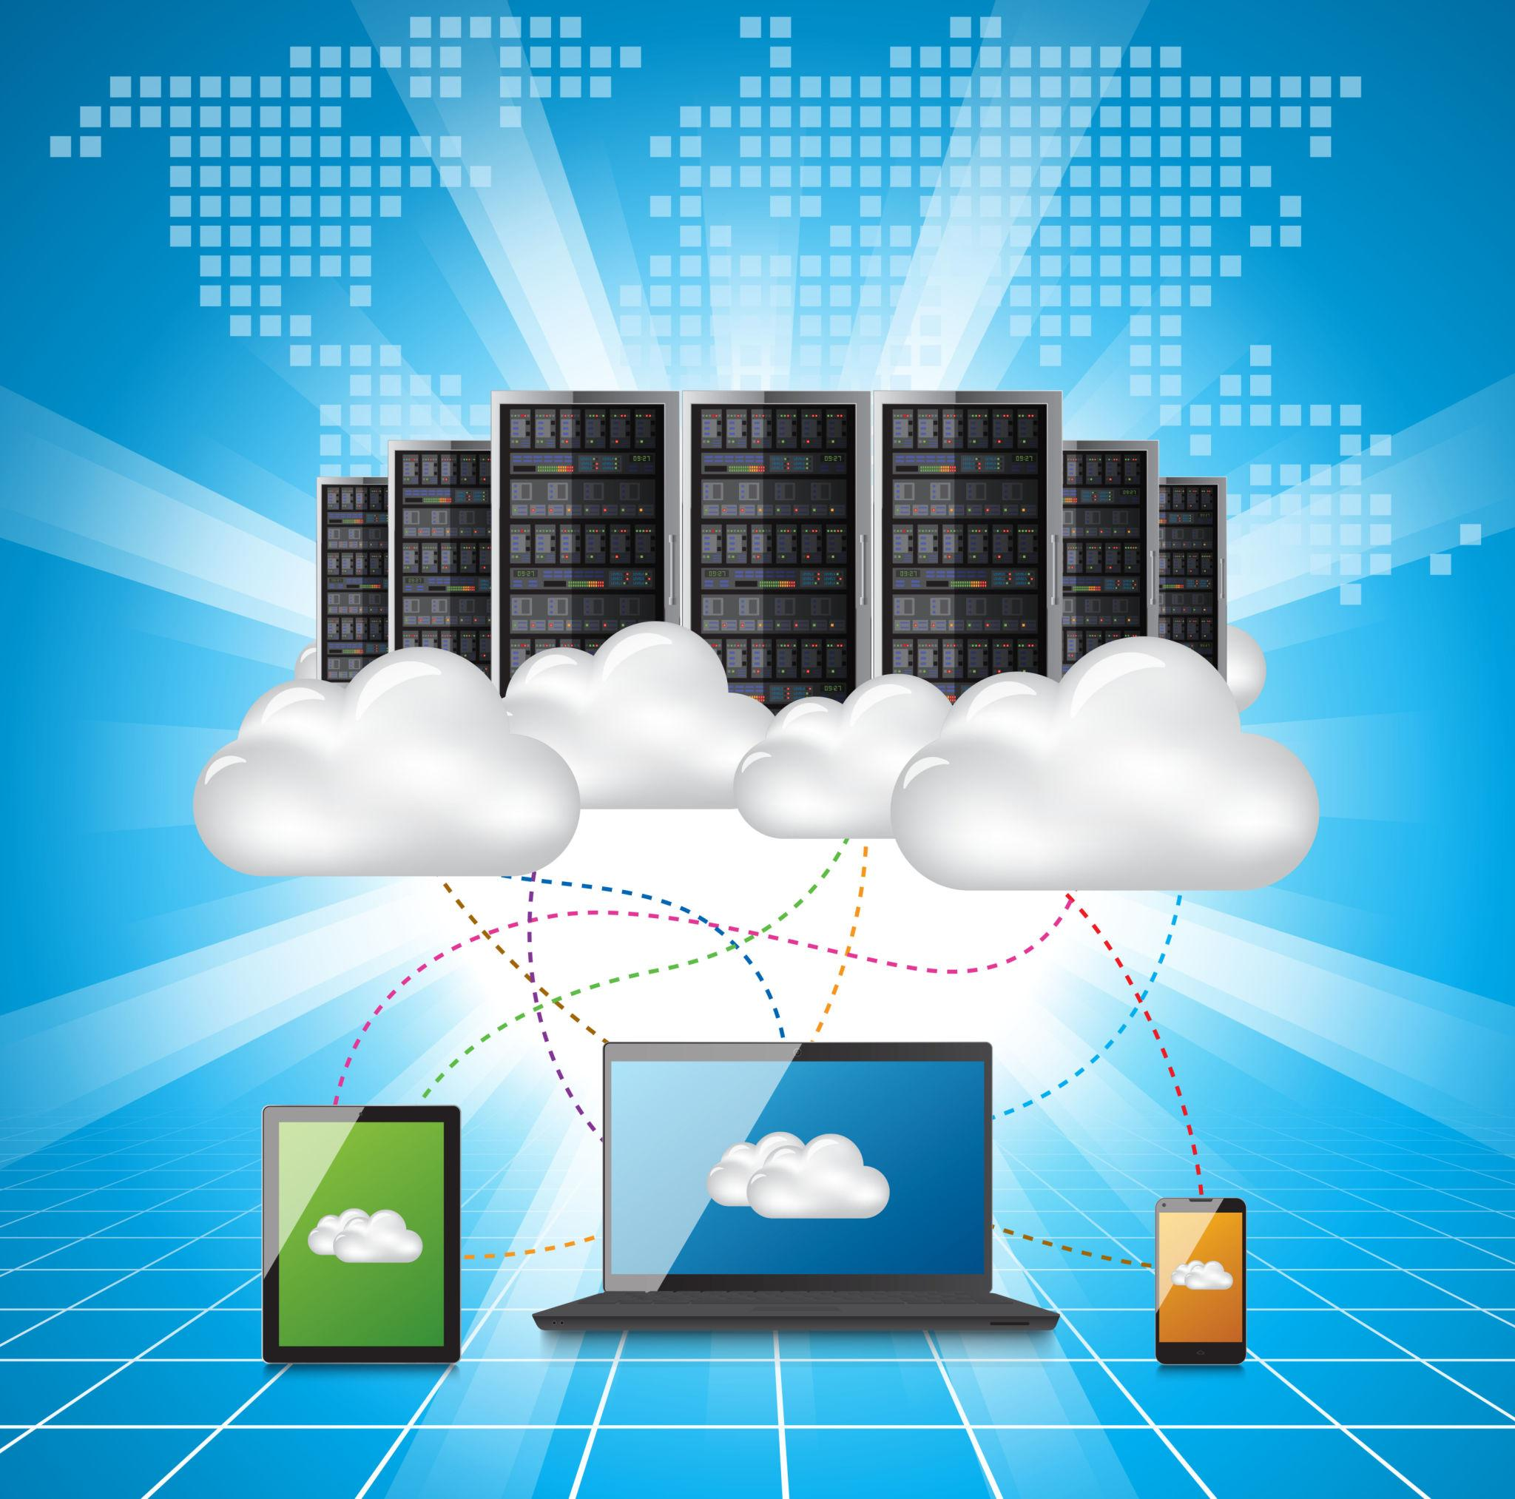
TECHNICAL ASPECTS
What is Cloud Computing?
Cloud computing is a technology that provides computing resources such as servers, storage, databases, and software over the internet.
Example: Google Drive stores your files online, allowing you to access them from different devices.
How it works:
A user sends a request through a device.
The request travels through the internet to a cloud data center.
Cloud servers process the request and store or retrieve data.
The result is sent back to the user.

Slide 5
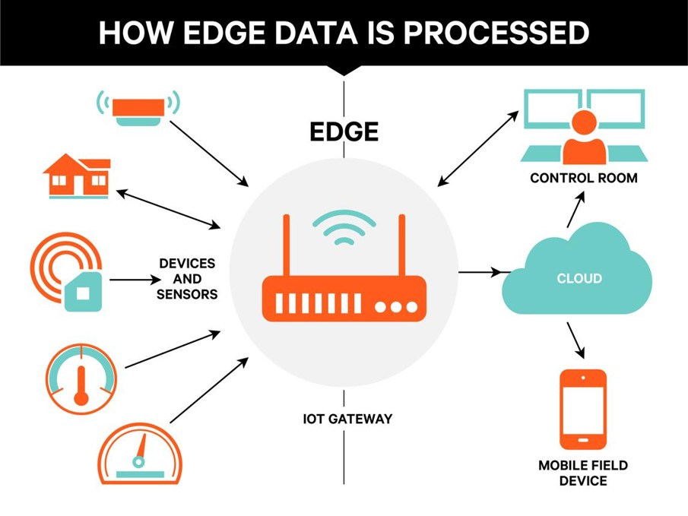
What is Edge Computing?
Edge computing processes data close to the device or location where it is generated, instead of sending all the data to a distant cloud server.
Example: A security camera detects a person locally and immediately triggers an alert.
How it works:
Devices such as sensors and cameras collect data.
A nearby edge device or gateway processes the data.
It produces an immediate response when required.
Important results can be sent to the cloud for long-term storage and analysis.

Slide 6
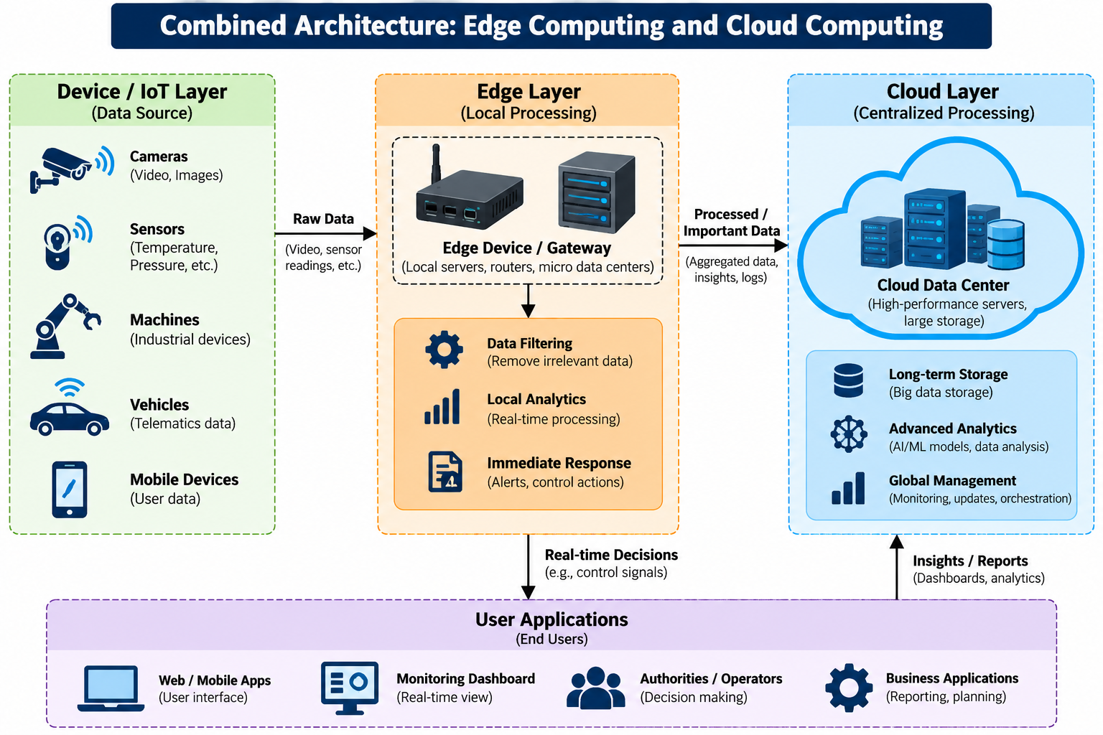
Architecture Diagram

Slide 7
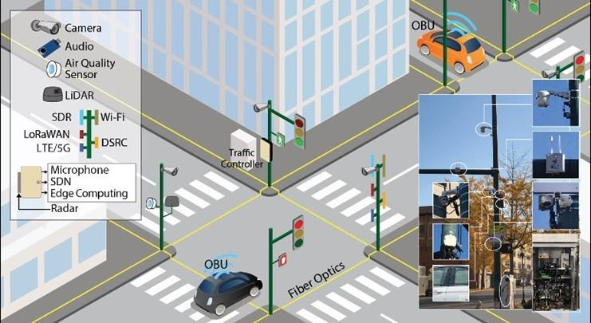
Real-World Use Case: Smart Traffic Management
Using edge computing:
Cameras detect the number of vehicles near a traffic signal.
An edge device processes the camera data locally.
The traffic signal adjusts its timing quickly based on traffic conditions.
This reduces delays caused by waiting for a remote cloud response.
Using cloud computing:
Traffic data from multiple intersections is sent to a central cloud platform.
The cloud analyzes traffic patterns across the entire city.
Authorities use reports to identify congested roads and plan better routes.

Slide 8
Conclusion
Edge computing and cloud computing are both important technologies in modern computing.
Choose edge computing when fast responses, low latency, and local processing are essential.
Choose cloud computing when you need large-scale storage, powerful computing resources, and centralized data analysis.
Choose both when a system needs immediate local decisions as well as long-term, large-scale analysis.

Slide 9


